Slide 1
Reading Files
Chapter 9
Notes:
Note from Chuck. If you are using these materials, you can remove the UM logo and replace it with your own, but please retain the CC-BY logo on the first page as well as retain the acknowledgement page(s) at the end.

Slide 2

It is time to go find some Data to mess with!
What
Next?
Software
Input
and Output
Devices
Central
Processing
Unit
Files R Us
Secondary
Memory
if x < 3: print
Main
Memory
From stephen.marquard@uct.ac.za Sat Jan 5 09:14:16 2008
Return-Path: <postmaster@collab.sakaiproject.org>
Date: Sat, 5 Jan 2008 09:12:18 -0500To: source@collab.sakaiproject.orgFrom: stephen.marquard@uct.ac.zaSubject: [sakai] svn commit: r39772 - content/branches/Details: http://source.sakaiproject.org/viewsvn/?view=rev&rev=39772
...

Slide 3
File Processing
A text file can be thought of as a sequence of lines
From stephen.marquard@uct.ac.za Sat Jan 5 09:14:16 2008
Return-Path: <postmaster@collab.sakaiproject.org>
Date: Sat, 5 Jan 2008 09:12:18 -0500
To: source@collab.sakaiproject.org
From: stephen.marquard@uct.ac.za
Subject: [sakai] svn commit: r39772 - content/branches/
Details: http://source.sakaiproject.org/viewsvn/?view=rev&rev=39772

Slide 4
Opening a File
Before we can read the contents of the file, we must tell Python which file we are going to work with and what we will be doing with the file
This is done with the open() function
open() returns a “file handle” - a variable used to perform operations on the file
Similar to “File -> Open” in a Word Processor

Slide 5
Using open()
fhand = open('mbox.txt', 'r')
handle = open(filename, mode)
returns a handle use to manipulate the file
filename is a string
mode is optional and should be 'r' if we are planning to read the file and 'w' if we are going to write to the file

Slide 6
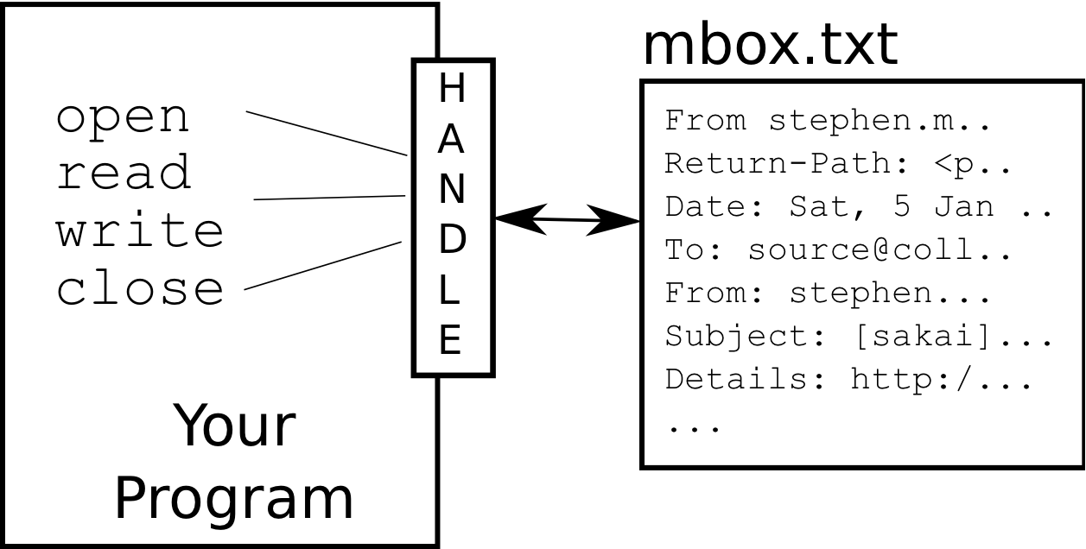
What is a Handle?
>>> fhand = open('mbox.txt')
>>> print(fhand)
<_io.TextIOWrapper name='mbox.txt' mode='r' encoding='UTF-8'>

Slide 7
When Files are Missing
>>> fhand = open('stuff.txt')
Traceback (most recent call last):
File "<stdin>", line 1, in <module>
FileNotFoundError: [Errno 2] No such file or directory: 'stuff.txt'

Slide 8
The newline Character
We use a special character called the “newline” to indicate when a line ends
We represent it as \n in strings
Newline is still one character - not two
>>> stuff = 'Hello\nWorld!'
>>> stuff
'Hello\nWorld!'
>>> print(stuff)
Hello
World!
>>> stuff = 'X\nY'
>>> print(stuff))
X
Y
>>> len(stuff)
3

Slide 9
File Processing
A text file can be thought of as a sequence of lines
From stephen.marquard@uct.ac.za Sat Jan 5 09:14:16 2008
Return-Path: <postmaster@collab.sakaiproject.org>
Date: Sat, 5 Jan 2008 09:12:18 -0500
To: source@collab.sakaiproject.org
From: stephen.marquard@uct.ac.za
Subject: [sakai] svn commit: r39772 - content/branches/
Details: http://source.sakaiproject.org/viewsvn/?view=rev&rev=39772

Slide 10
File Processing
A text file has newlines at the end of each line
From stephen.marquard@uct.ac.za Sat Jan 5 09:14:16 2008\n
Return-Path: <postmaster@collab.sakaiproject.org>\n
Date: Sat, 5 Jan 2008 09:12:18 -0500\n
To: source@collab.sakaiproject.org\n
From: stephen.marquard@uct.ac.za\n
Subject: [sakai] svn commit: r39772 - content/branches/\n
\n
Details: http://source.sakaiproject.org/viewsvn/?view=rev&rev=39772\n

Slide 11
Reading Files in Python

Slide 12
File Handle as a Sequence
A file handle open for read can be treated as a sequence of strings where each line in the file is a string in the sequence
We can use the for statement to iterate through a sequence
Remember - a sequence is an ordered set
xfile = open('mbox.txt')
for cheese in xfile:
print(cheese)

Slide 13
Counting Lines in a File
Open a file read-only
Use a for loop to read each line
Count the lines and print out the number of lines
fhand = open('mbox.txt')
count = 0
for line in fhand:
count = count + 1
print('Line Count:', count)
$ python open.py
Line Count: 132045

Slide 14
Reading the *Whole* File
We can read the whole file (newlines and all) into a single string
>>> fhand = open('mbox-short.txt')
>>> inp = fhand.read()
>>> print(len(inp))
94626
>>> print(inp[:20])
From stephen.marquar

Slide 15
Searching Through a File
We can put an if statement in our for loop to only print lines that meet some criteria
fhand = open('mbox-short.txt')
for line in fhand:
if line.startswith('From:') :
print(line)

Slide 16
OOPS!
From: stephen.marquard@uct.ac.za
From: louis@media.berkeley.edu
From: zqian@umich.edu
From: rjlowe@iupui.edu
...
What are all these blank lines doing here?

Slide 17
OOPS!
Each line from the file has a newline at the end
The print statement adds a newline to each line
What are all these blank lines doing here?
From: stephen.marquard@uct.ac.za\n
\n
From: louis@media.berkeley.edu\n
\n
From: zqian@umich.edu\n
\n
From: rjlowe@iupui.edu\n
\n
...

Slide 18
Searching Through a File (fixed)
We can strip the whitespace from the right-hand side of the string using rstrip() from the string library
The newline is considered “white space” and is stripped
fhand = open('mbox-short.txt')
for line in fhand:
line = line.rstrip()
if line.startswith('From:') :
print(line)
From: stephen.marquard@uct.ac.za
From: louis@media.berkeley.edu
From: zqian@umich.edu
From: rjlowe@iupui.edu
....

Slide 19
Skipping with continue
We can conveniently skip a line by using the continue statement
fhand = open('mbox-short.txt')
for line in fhand:
line = line.rstrip()
if not line.startswith('From:') :
continue
print(line)

Slide 20
Using in to Select Lines
fhand = open('mbox-short.txt')
for line in fhand:
line = line.rstrip()
if not '@uct.ac.za' in line :
continue
print(line)
We can look for a string anywhere in a line as our selection criteria
From stephen.marquard@uct.ac.za Sat Jan 5 09:14:16 2008
X-Authentication-Warning: set sender to stephen.marquard@uct.ac.za using –f
From: stephen.marquard@uct.ac.za
Author: stephen.marquard@uct.ac.za
From david.horwitz@uct.ac.za Fri Jan 4 07:02:32 2008
X-Authentication-Warning: set sender to david.horwitz@uct.ac.za using -f...

Slide 21
Prompt for File Name
fname = input('Enter the file name: ')
fhand = open(fname)
count = 0
for line in fhand:
if line.startswith('Subject:') :
count = count + 1
print('There were', count, 'subject lines in', fname)
Enter the file name: mbox.txt
There were 1797 subject lines in mbox.txt
Enter the file name: mbox-short.txt
There were 27 subject lines in mbox-short.txt

Slide 22
Bad File Names
fname = input('Enter the file name: ')
try:
fhand = open(fname)
except:
print('File cannot be opened:', fname)
quit()
count = 0
for line in fhand:
if line.startswith('Subject:') :
count = count + 1
print('There were', count, 'subject lines in', fname)
Enter the file name: mbox.txt
There were 1797 subject lines in mbox.txt
Enter the file name: na na boo boo
File cannot be opened: na na boo boo

Slide 23
CSV file
Table of Contents:
What is a CSV?
Reading a CSV
Writing to a CSV

Slide 24
What is a CSV?
CSV stands for “Comma Separated Values.”
It is the simplest form of storing data in tabular form as plain text.
It is important to know to work with CSV because we mostly rely on CSV data in our day-to-day lives as data scientists.

Slide 25
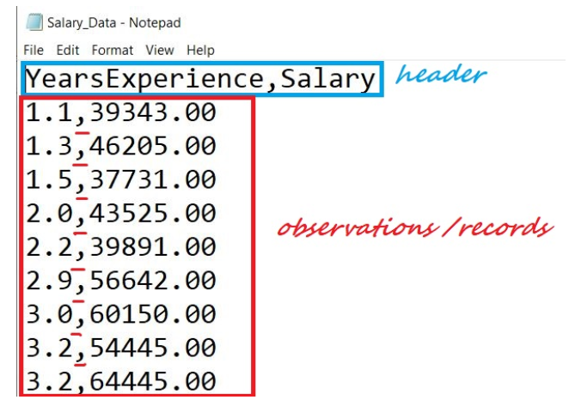
Structure of CSV:
We have a file named “Salary_Data.csv.” The first line of a CSV file is the header and contains the names of the fields/features.
After the header, each line of the file is an observation/a record. The values of a record are separated by “comma.”

Slide 26
Reading a CSV:
import csv
file = open("Salary_Data.csv")
csvreader = csv.reader(file)
header = next(csvreader)
print(header)
rows = []
for row in csvreader:
rows.append(row)
print(rows)
file.close()

Slide 27
implementing the code using with() statement:
import csv
rows = []
with open("Salary_Data.csv", 'r) as file:
csvreader = csv.reader(file)
header = next(csvreader)
for row in csvreader:
rows.append(row)
print(header)
print(rows)

Slide 28
Libraries in python
https://www.w3schools.com/python/

Slide 29
Summary
Secondary storage
Opening a file - file handle
File structure - newline character
Reading a file line by line with a for loop
Searching for lines
Reading file names
Dealing with bad files
CSV file

Slide 30
Practice for File
Write a program that prompts for a file name, then opens that file and reads through the file, looking for lines of the form:
X-DSPAM-Confidence: 0.8475
Count these lines and extract the floating point values from each of the lines and compute the average of those values and produce an output as shown below. Do not use the sum() function or a variable named sum in your solution.
when you are testing below enter mbox-short.txt as the file name.
Output: Average spam confidence: 0.7507185185185187

